Slide 1

INFOSESSION CfP REDD+ GROUND-TRUTH PROJECTS
JULY 5TH, 2019

Slide 2
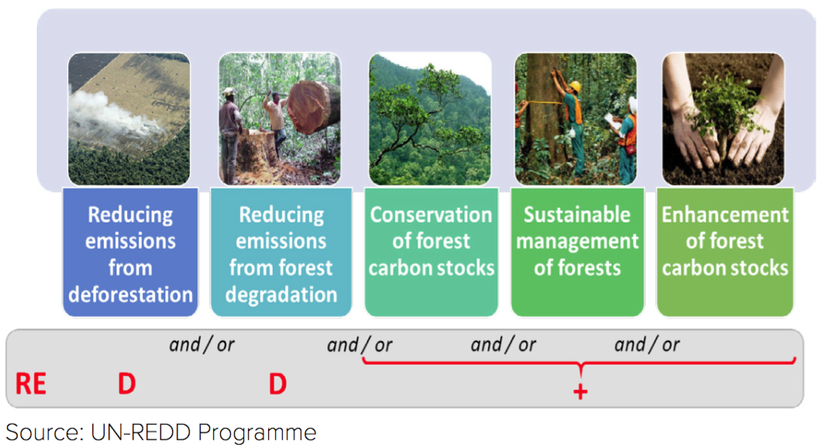
REDD+

Slide 3
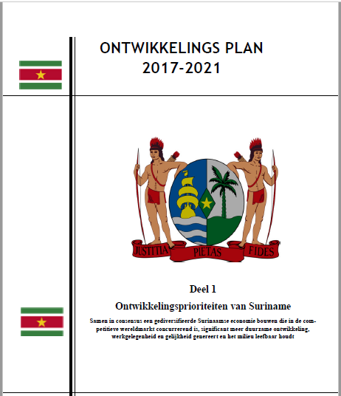
Suriname REDD+ Model
A Planning Mechanism to support the achievement of economic and development goals in general (diversify the economy), and especially the following aspects:
GDP increase
Infrastructural development
Development of sectors, e.g. mining, forestry, agriculture
A Financing Mechanism for stimulating sustainable national development.

Slide 4
REDD+ Phases
Readiness
Development of National REDD+ Strategy
Establishment of Systems (NFMS, SIS, BSM, GRM)
Implementation
Implementation of National REDD+ Strategy
Implementation REDD+ pilot projects
Results- Based Activities
Quantified emission reduction
Community engagement
Further capacity building
Institutional strengthening and capacity building
Financial compensation
Results are monitored and measured, reported and verified
Improved forest management

Slide 5
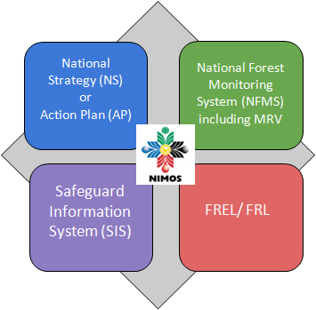

Status Suriname: REDD+ Readiness
National REDD+ Strategy: Final draft completed.
NFMS: Operational
FREL/FRL: (2016 – 2020: completed)
SIS: Started; will be completed in 2019
⇒ Started with Resource Mobilization for implementation of National REDD+ Strategy

Slide 6
REDD+ PROGRAM: MULTI-YEAR WORK PLAN 2019 – 2020: Main activities
Designing a Benefit Sharing Mechanism
Developing a National REDD+ Registry
Developing a National Safeguards Information System (SIS)
Establishment of a REDD+ Grievance Redress Mechanism (GRM)
Strengthening of the National Forest Monitoring System (NFMS)
Development of the 2nd FREL/ FRL
Designing and implementing ground-truth projects on sustainable economic development opportunities for national rights holders and stakeholders

Slide 7
Act. 2b2: Designing and implementing ground-truth projects on sustainable economic development opportunities for national rights holders and stakeholders
OBJECTIVES:
Strengthening and fine-tuning the Policies and Measures (PAMs) of the National REDD+ Strategy in order to make potential results of REDD+ more tangible and show more concretely what REDD+ can mean to ITP communities, the private sector and other rights holders and stakeholders
Capacity building of and preparing (potential) partners in implementing activities on the ground, which will be crucial in the REDD+ implementation phase
Broadening the institutionalization of REDD+ as a long-term process/program in support of sustainable development in Suriname
Creating and showcasing synergies and more national and local level buy-in for REDD+ by creating linkages between the REDD+ Program and other ongoing projects and programs

Slide 8
ACTIVITIES
Activity | Details
Community Forest Management (beheer van gemeenschapsbos) | Sustainable forest management in community forests. Capacity building/ training. Sustainable harvesting and processing of wood.
Promotion of nature- and ecotourism, agro-forestry, medicinal plants, Non Timber Forest Products (NTFPs), and other sectors with a view to providing alternative livelihoods to forest dependent communities and aid in the diversification of the economy | Sustainable harvesting and processing of NTFPs. Capacity building of communities and setting up infrastructure (e.g. processing facilities). Create market access. Create market demand and ensure support in marketing and small business development. Promoting more efficient soil conserving agricultural and agroforestry techniques. Capacity building to promote agroforestry practices.

Slide 9
ACTIVITIES
Activity | Details
Promotion of activities related to innovative and alternative economic development in sectors such as forestry and agriculture, with a view to achieving a national sustainable socio-economic development. | Supporting sustainable practices in land use sectors, such as forestry and agriculture, which has the potential to diversify the national economy.
Building capacity of or providing training programs to rights holders and stakeholders, including, among others, the Private sector, Government and Semi-Government institutions, ITPs. | Alternative livelihoods; sustainable forest management; forest governance; forest monitoring, control and protection; entrepreneurship and business planning; etc.
Promotion of (applied) scientific research and education on forest management, including, among others, capacity building and strengthening of research and education institutions. | Promotion of scientific research to improve forest use. Strengthening or establishing academic programs relevant for supporting the REDD+ implementation. Stimulating interest and awareness of the forest sector, adapting the curricula at different levels of the educational system, and training of officers and operators.

Slide 10
Eligible Applicants/ Target group(s)
Private sector: (e.g. forestry, alternative economic opportunities such as NTFPs, nature- and ecotourism, agro-forestry, medicinal plants)
Government/ Semi-Governmental Organizations
Research and Education Institutions
Indigenous and Tribal Peoples (ITPs)
Non-Governmental Organizations (NGOs)
Community Based Organizations (CBOs)
The applicant should be a Suriname based organization/ legal entity according to Surinamese law eventually partnering with international NGOs/ Institutions.
National Institutions should have the lead in case the project will be conducted in partnership with International NGOs/ Institutions.
Strictly ONE project proposal per organization. However, member(s) of an organization can be part of other organizations submitting another proposal.

Slide 11
The Suriname REDD+ Project
Project Management Unit
Mr. Jaggernath Lachmonstraat no. 93, Paramaribo, Suriname
Tel: 532405 or 430440 / E-mail: reddprojects@nimos.org / Website: www.surinameredd.org

